Slide 1
ELEEP webinar
Transatlantic competition under the Paris Agreement – Insights on the concept of “carbon leakage”
27 July 2017
Benjamin Görlach, Ecologic Institute

Slide 2
Carbon Leakage – the Basics
What are we talking about? – What are the Forms and Channels of Carbon Leakage?
Is carbon leakage a problem – and why?
Which sectors are at risk of carbon leakage?
Going forward – Which assumptions may need to be revisited?
(How to prevent leakage?)

Slide 3
Carbon leakage: What are we talking about?
IPPC: “phenomena whereby the reduction in emissions (relative to a baseline) in a jurisdiction / sector associated with the implementation of mitigation policy is offset to some degree by an increase outside the jurisdiction / sector through induced changes in consumption, production, prices, land use and/or trade across the jurisdictions / sectors”
IEA: leakage rate is “the ratio of emissions increase from a specific sector outside the country (as a result of a policy affecting that sector in the country) over the emission reductions in the sector (again, as a result of the environmental policy)
Common usage: a reduction of GHG emissions by shifting GHG-emitting activities to another country, driven by differences in carbon regulation

Slide 4
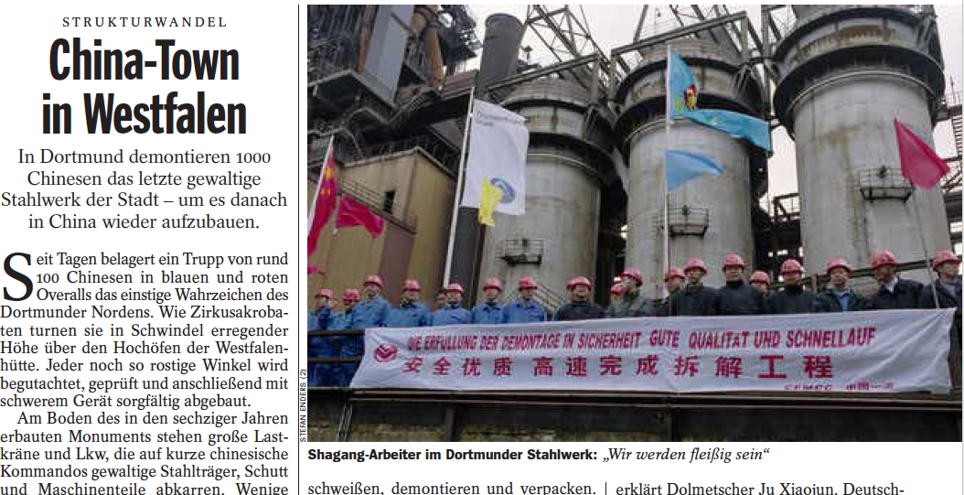
Carbon Leakage in Action?
DER SPIEGEL, 08.04.2002

Slide 5
How does Carbon Leakage work? Forms and Channels
Operational leakage: the “Relocation” of production from existing production capacities, could take the form of:
Physical relocation of plants – very rare in real life;
Relocation of production volumes between installations operated by the same company;
Changes in market shares.
Investment leakage: investing more into expanding capacities in regions with a weaker carbon constraint
Leakage through energy resource markets
(In-country leakage from the sectors with a carbon price to non-priced)

Slide 6
Carbon leakage: Is it a problem, and why?
In principle, it could be a problem:
Effectiveness of climate policy suffers: reduction is (partly) offset abroad
Efficiency of climate policy suffers: Production could become more polluting
Political feasibility of climate policy suffers (and therefore policy ambition): Unfair distortion of competition, loss of income and jobs

Slide 7
Carbon leakage: Is it a problem, and why?
But is it really a problem?
Evidence: model-based ex-ante studies find a leakage risk – but empirical ex-post studies show little or no conclusive evidence of actual leakage
Carbon leakage – very hard to separate from the baseline. Reinforcement of an ongoing trend?
Tackling leakage = Conservation programme for dinosaurs? Preventing necessary structural change towards a low-carbon economy?
The phenomenon of “clean leakage” – production actually cleaner abroad?

Slide 8
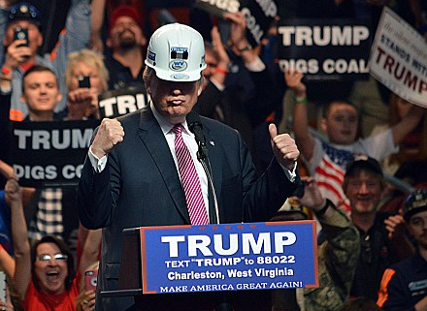
The Paris climate accord is simply the latest example of Washington entering into an agreement that disadvantages the United States to the exclusive benefit of other countries, leaving American workers – who I love – and taxpayers to absorb the cost in terms of lost jobs, lower wages, shuttered factories, and vastly diminished economic production.

Slide 9
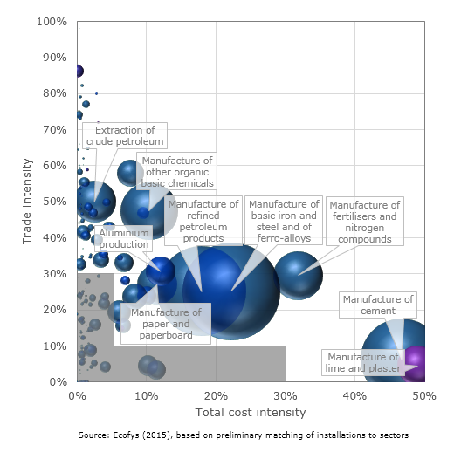
Leakage risk: which sectors are exposed?
Common understanding: carbon leakage risk as a combination of
Cost burden resulting from of the carbon price (emission intensity)
Exposure to international competition (proxy: trade intensity)

Slide 10
Going forward – Which assumptions are in need of review?
Differences in climate policy / carbon constraints – now and in the future
Intensity of international competition and cost pass-through
Plenty of other ways how regulation affects the competitive position:
Energy prices
Overcapacities and subsidies
Openly protectionist policies
Resource efficiency, breakthrough innovation, low-carbon industries – managing the structural change

Slide 11
What are policy responses to tackle carbon leakage?
Policy responses to carbon leakage aim at levelling the playing field: reduce the impact of carbon pricing on domestic producers, create a burden on foreign producers, or achieve convergence through cooperation
Preferential allocation rules for affected domestic producers (ex ante allocation or ex-post rebates)
Adjustments at the border: tariffs and equivalent burdens or rebates
Convergence of mitigation efforts
Through a global or sectoral agreement on comparable mitigation efforts;
Convergence of carbon prices through market linking

